Slide 1

object-oriented systems in R
Ildi Czeller : @czeildi
Notes:
Welcome everyone, I will introduce you to object-oriented systems in R.

Slide 2
- Data Scientist @Emarsys - 3 years R - started with C++, Python
Me:
Notes:
A little bit about myself: I am a data scientist at Emarsys for 3 years now using mainly R. Previously I also learned C++ and Python which gives me some perspective to understand how object-orientation in R is different from other languages and how it is also similar.

Slide 3
- R user without CS background - understand core concepts - explore & debug more effectively
You:
Notes:
I think this talk will be the most useful if you are one of many R users without formal computer science background (including myself). At the end of this talk I hope you will understand core concepts which will enable you to debug and explore existing code more effectively. Actually, my personal motivation to learn about this topic also stems from a series of painful debugging sessions.

Slide 4
summary(lm(y~x))
summary(c(1:99, 10^6))
...
Coefficients:
...
Signif codes: 0 ‘***’
Multiple R-squared: 0.7262
Min. : 1.0
1st Qu.: 25.8
Median : 50.5
Mean : 10049.5
3rd Qu.: 75.2
Max. :1000000.0
Notes:
Probably all of you already used object orientation, you were just not aware of it. For example if you call the summary function with a linear model, you get things like coeffecients and performance metrics. On the other hand if you call the same summary function with a vector or data frame, it will return the min, median and max for you. So you called the same function with fundamentally different types and the function returned the appropriate result for you.

Slide 5

object =
behavior
+
data
attend -> learn talk at -> feedback organize -> proud
date: 2018-10-27 venue: Belgrade # participants: 100+
Notes:
Objects are in the center. What are objects? They consist of data and behavior. Let’s imagine this conference would be an object. The data and type of behavior are specific to conferences, you cannot really talk at data frames. There are multiple ways to handle object orientation. Different languages take different approaches. There are even different approaches within R.

Slide 6
S3
Notes:
Today I will focus on S3, which is the oldest, simplest and most widely used system in R. However, you should be aware that it is quite different than in Python for example. You can have objects without an object-oriented system. The system enables working with objects and attached behavior in a scalable way. You could write if statements based on argument type but it would be neither scalable, nor extensible.

Slide 7
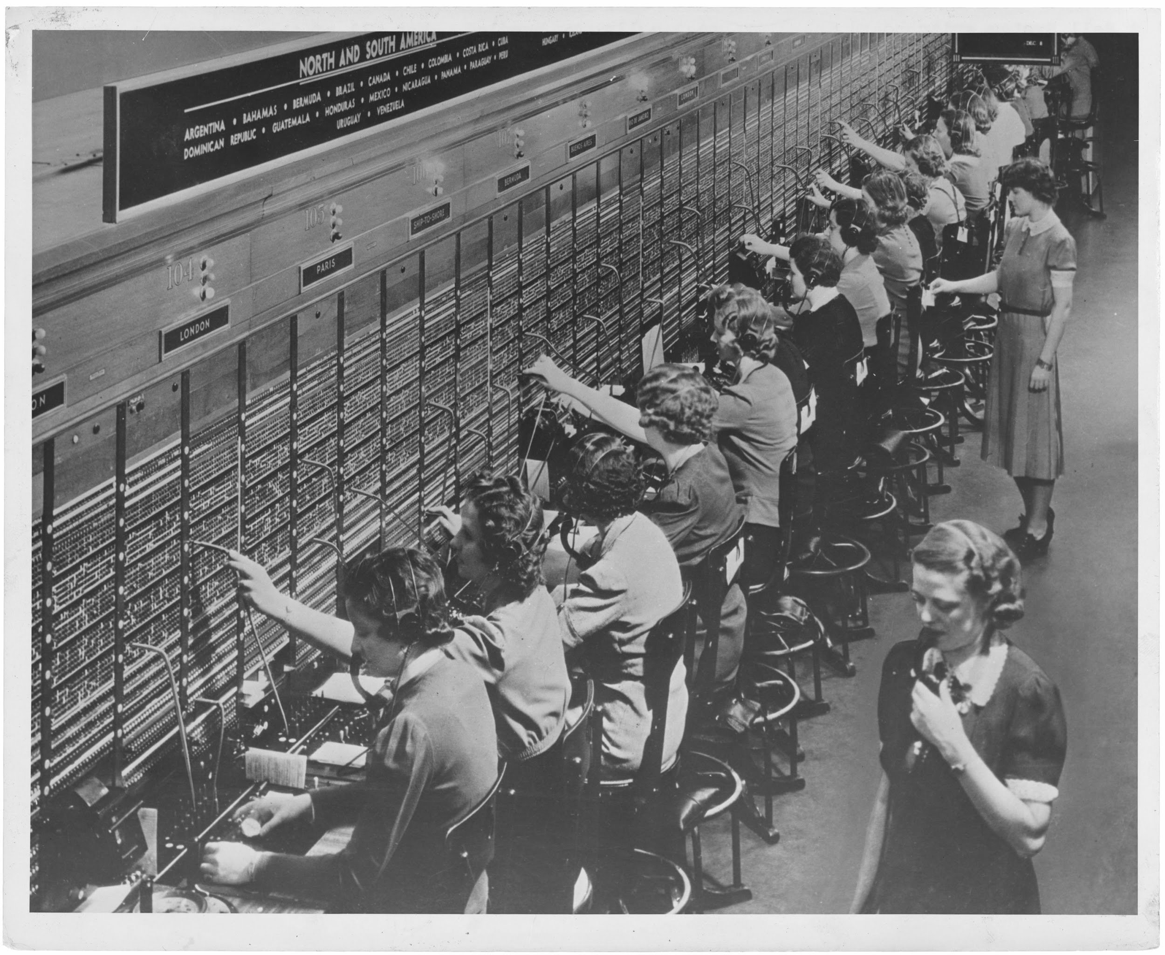
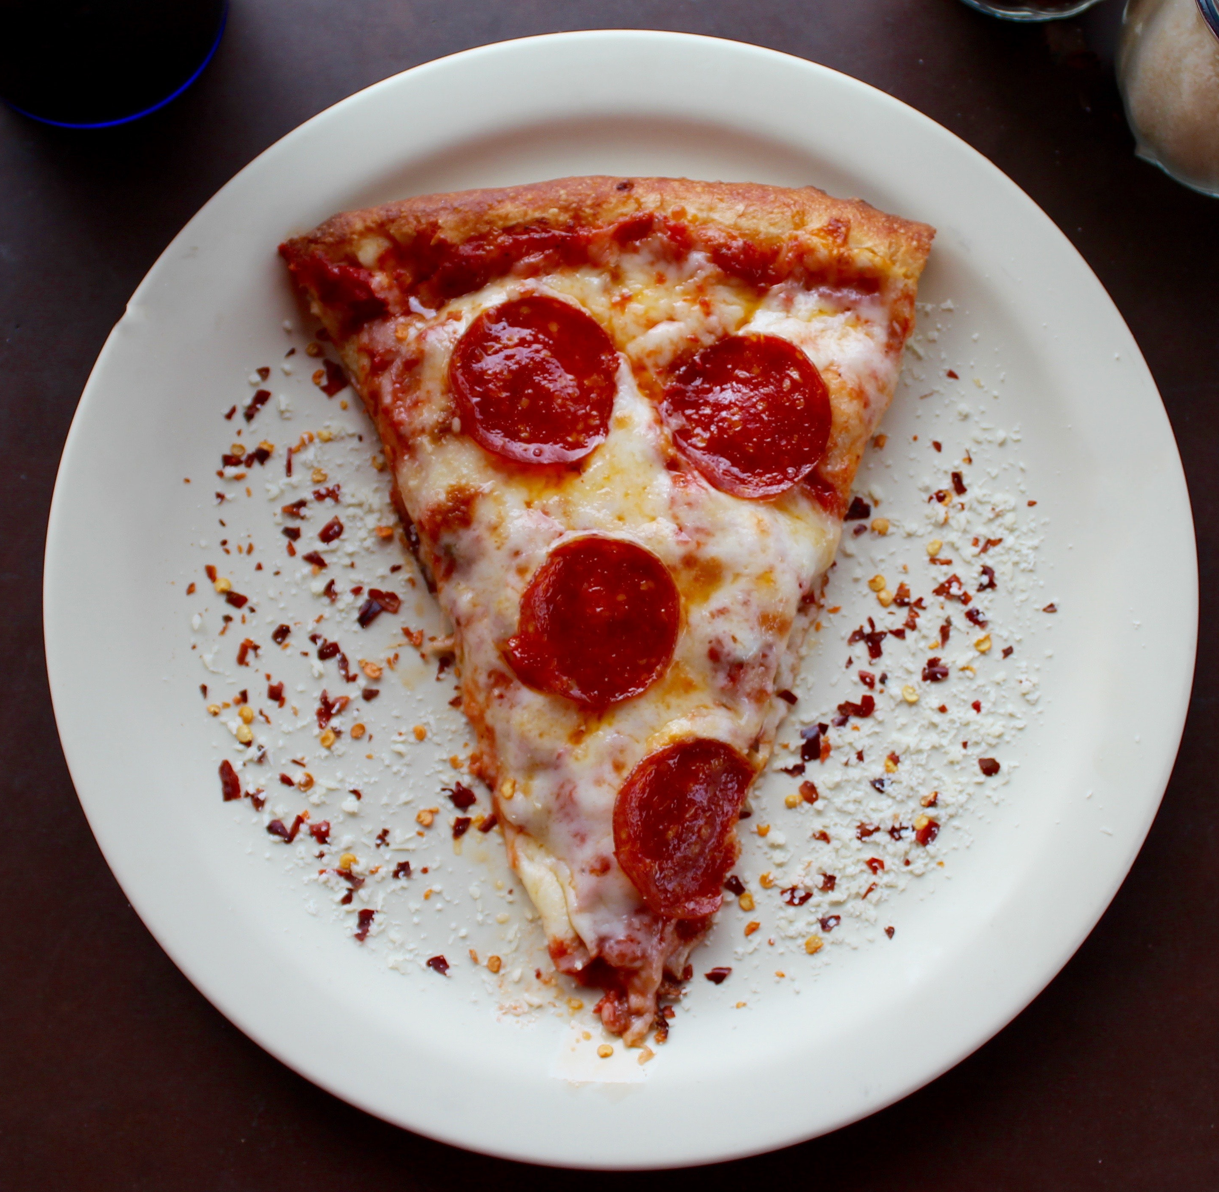

+36 1 333-3333
Notes:
What is in the center of S3? Let’s time travel back to the sixties and imagine what happens if you call the pizza delivery service. Your call will be forwarded to the telephone center, where they know how you should be connected to the pizza delivery guy. They connect you and then the delivery guy will do the actual work of baking and delivering pizza for you.

Slide 8
lm(y~x)
summary.lm
Coef R^2
summary
Notes:
A similar thing happens in R. You can call the summary function with a linear model. Then in the background, hidden from you, R will call a specific function, summary.lm for you which will do the actual work of calculating coefficients.

Slide 9
class + generic
dispatch method
lm(y~x)
+
summary.lm
summary
Notes:
There are 4 main concepts participating in this process which you will understand in more detail. Objects like linear model or data frames have class that determines their possible behavior. Generics like summary are the function that you as an end user usually calls. Dispatch is the mechanism through which you are connected to the method and the methods are the specific functions that can deal with a specific type.

Slide 10
details
Notes:
Lets understand these 4 concepts in more detail.

Slide 11



class / object type
Notes:
Class is an abstract notion. Every object either belongs to the class or not. The set of all objects belonging to a class should share many properties and possible behavior. It is not enforced by R but it is what makes classes useful: in many cases you can handle objects from the same class in the same way. Though sometimes you cannot: you should be aware how objects are similar and how are they different.

Slide 12
type/class in R
integer
character
list
Date
data.frame
r_conference
base types
S3 types
Notes:
There are base types which are the building blocks of everything else. For example integer, character and list are built in types. There are more complex types built from base types, the most commonly used by you are probably date and data frame. We could also create an r conference class. (base types do not have a class attribute, S3 types must have, still their class is present and enforced by base R code.)

Slide 13
method
summary.lm
generic
class
as.factor
Notes:
Methods are functions with a specific naming pattern and they implement functionality for a specific type. All methods must be named as generic.class. But do not be fooled, unfortunately not all functions containing a dot in their name are S3 object oriented methods. Methods implement behavior for a specific class.

Slide 14
method
summary.data.frame
generic
class
as.Date.numeric
generic
class
Notes:
Further examples are … This maybe shows you why modern style guides discourage the use of dot outside the context of object orientation: it is confusing.

Slide 15
generic
summary <- function(object, …)
UseMethod(“summary”)
sum <- function(…, na.rm = FALSE)
.Primitive(“sum”)
Notes:
The third concept is generics: their job is to forward your call to the appropriate method. You can recognize them by that they only contain one line: useMethod. There are also many functions in R actually implemented in C for performance reasons, in their case you can recognize generics by .Primitive.
Generics tend to have generic argument names and … so that they are flexible.

Slide 16
summary(lm(y~x))
dispatch
summary.lm(lm(y~x))
Coefficients: …
Signif codes: 0 ‘***’
Multiple R-squared: 0.7262
Notes:
Dispatch connects these pieces together. It happens in the background usually hidden from you. It is the process of finding and calling the appropriate method based on the generic and type of the arguments.

Slide 17
why so powerful?
Notes:
We have seen how S3 works. Why is it so powerful? Why do people use it? Why do the creators of R use it?

Slide 18
flexible & extensible
Notes:
This is really powerful because it is flexible and extensible. What do I mean by that?

Slide 19
base R + different packages work together
Notes:
You can define methods for a generic like summary or class like data frame in base R and many different packages. It makes it easy to work together and create useful functions.

Slide 20
complex types can inherit behavior from simpler types
Notes:
Another part of extensibility: you can benefit from the work of others, no need to rewrite everything from scratch.

Slide 21
class is a vector
c(”r_conference”, “conference”, “event”)
most specific → → → least specific
Notes:
Inheritance is made possible by the fact that class is actually a vector where order is important: it contains types from most specific to least specific. This is the developer’s responsibility: it should make sense and be useful. One example is that data tables are also data frames. Lets’ look at how this can be utilized.

Slide 22
specialize
print(data.table())
print.data.table(data.table())
Sepal.Length Sepal.Width 1: 5.1 3.5 2: 4.9 3.0 3: 4.7 3.2 4: 4.6 3.1 5: 5.0 3.6 --- 146: 6.7 3.0 147: 6.3 2.5 148: 6.5 3.0 149: 6.2 3.4 150: 5.9 3.0
print(data.frame())
print.data.frame(data.frame())
Sepal.Length Sepal.Width 1 5.1 3.5 2 4.9 3.0 3 4.7 3.2 4 4.6 3.1 5 5.0 3.6 6 5.4 3.9 7 4.6 3.4 8 5.0 3.4 9 4.4 2.9 10 4.9 3.1
…
Notes:
With inheritance the developer can choose to specialize behavior.

Slide 23
fallback
summary(data.table())
summary.data.table(data.table())
summary.data.frame(data.table())
Sepal.Length Min. :4.300 1st Qu.:5.100 Median :5.800 Mean :5.843 3rd Qu.:6.400 Max. :7.900
summary(data.frame())
summary.data.frame(data.frame())
Sepal.Length Min. :4.300 1st Qu.:5.100 Median :5.800 Mean :5.843 3rd Qu.:6.400 Max. :7.900
Notes:
You can also decide to rely on existing behavior: this happens by default if no specialized function is defined.

Slide 24


extend
gift.conference
gift.r_conference
Notes:
The third thing you can do is extend behavior: keep what is working and add additional functionality.

Slide 25
learn more
Notes:
We only touched the topic so I would like to give you some pointers to learn more if you are interested.

Slide 26
explore
seq.Date
data.table:::print.data.table
lookup::lookup(“sum”) – Jim Hester
https://github.com/wch/r-source
Notes:
One good way of learning is to inspect the code you are already using. Simplest case, if function is not exported, code in base R written in C.

Slide 27
explore
sloop – R package by Hadley Wickham
s3_class, ftype
s3_dispatch
s3_methods_class, s3_methods_generic
Notes:
Another way to explore is the sloop package written by Hadley Wickham for educational purposes.

Slide 28
Advanced R by Hadley Wickham https://www.ildiczeller.com/2018/04/02/investigating-difftime-behavior/
Notes:
Personally I learned a lot from debugging and exploring, in the above link you can read about a debugging case study related to object orientation.

Slide 29
take-away
Notes:
No need to create new classes in order to utilize object orientation.

Slide 30
use understand (create)

